Slide 1

Python Web Basics
Course Introduction
SoftUni Team
Technical Trainers
Software University
https://softuni.bg/

Slide 2
Table of Contents
Course Objectives
Training and Team
Course Organization
Course Infrastructure
Evaluation Criteria
2

Slide 3
Have a Question?
sli.do
#python-web

Slide 4











SoftUni Diamond Partners
4
4

Slide 5



Educational Partners

Slide 6

Course Objectives

Slide 7
Python Web Basics Objectives
Working with HTTP Requests
Get familiar with the MVC architecture
Get familiar with the basic Web concepts
Working with SQL
Build servers
Build the foundations of Django web development
7

Slide 8
Practical Programming Exam
Exam – 4 hours
1 practical problem - creating simple CRUD application
8

Slide 9
Theoretical Exam
You will have 30 minutes once you enter
Multiple-choice with 1 correct answer
Test will be in English
Automated quiz system
Available on the day of the practical exam
You can submit your answers just one time
9

Slide 10

The Team

Slide 11
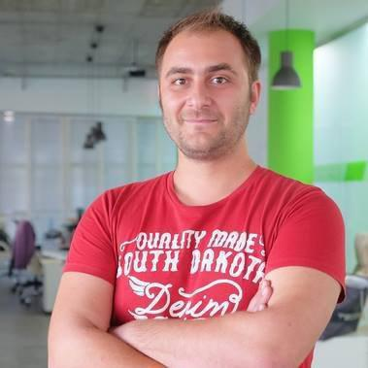
Doncho Minkov
Technical lead, Architect and DevOps at SoftUni
10+ years of experience as a Technical Trainer
Front-end developer by heart
Software developer by need
Experienced in Django, Node.js, .NET and others
Fluent in Python, JavaScript, C#, Java, C++
"30 under 30" – Forbes 2017 - Education

Slide 12

Course Organization

Slide 13
Python Web Basics Course
18-May-2021
27-Jun-2021
11-Aug-2021
Python Advanced
6 weeks * 2 times / week
12 credits
Start: 18-May-2021
Theoretical Exam: 27-Jun-2021
Final exam: 27-Jun-2021
Re-Take Exams
Theoretical Retake Exam: 11-Aug-2021
Final Exam Retake: 11-Aug-2021

Slide 14


SoftUni Certificate
Practical Exam 100%
Evaluation
14

Slide 15
CPE Certificate
Practical Exam
Theoretical Exam
Evaluation
15

Slide 16


Course Web Site, Forum and FB Group
Official web site:
Softuni Python Community group:
https://softuni.bg/courses/python-web-basics
https://www.facebook.com/groups/SoftUniPythonCommunity

Slide 17
Questions?
Notes:
17

Slide 18
Trainings @ Software University (SoftUni)
Software University – High-Quality Education, Profession and Job for Software Developers
softuni.bg, softuni.org
Software University Foundation
softuni.foundation
Software University @ Facebook
facebook.com/SoftwareUniversity
Software University Forums
forum.softuni.bg
18
Notes:
18

Slide 19

License
This course (slides, examples, demos, exercises, homework, documents, videos and other assets) is copyrighted content
Unauthorized copy, reproduction or use is illegal
© SoftUni – https://about.softuni.bg
© Software University – https://softuni.bg
Notes:
19

